Slide 1

robWAR

Slide 2
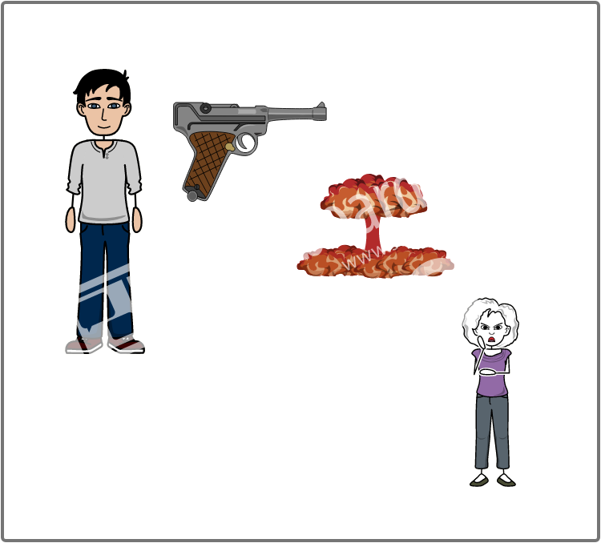
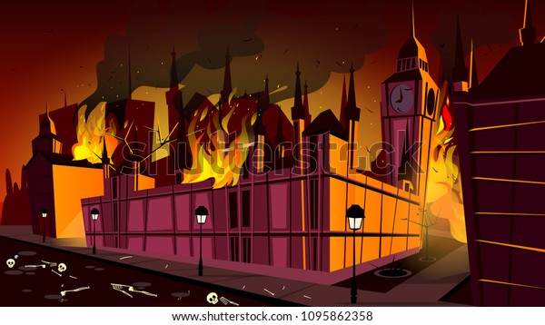
Someone's Stolen our Bomb
Evil Ed has stolen our bomb and is threatening to blow up parliament
Em has to get it back. But how?

Slide 3
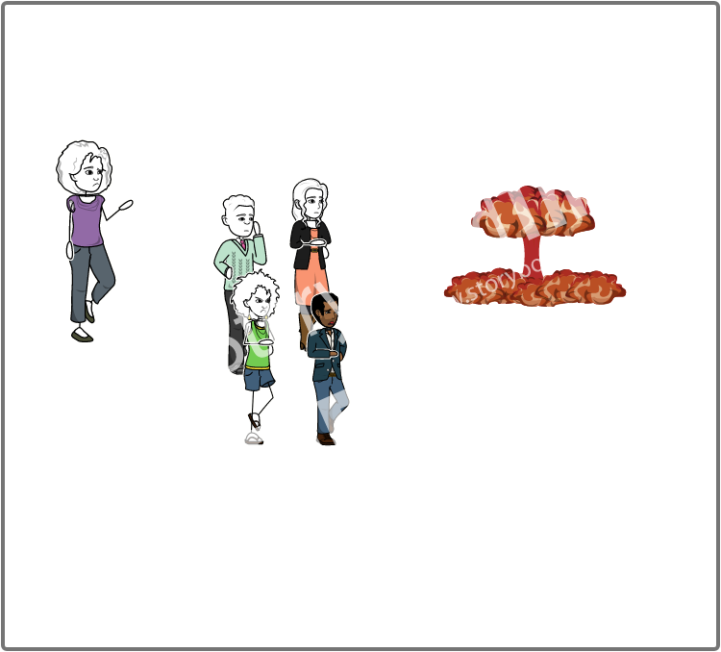
Go Get the Bomb Back
Em gets her spies together and sends them out to find the bomb.

Slide 4
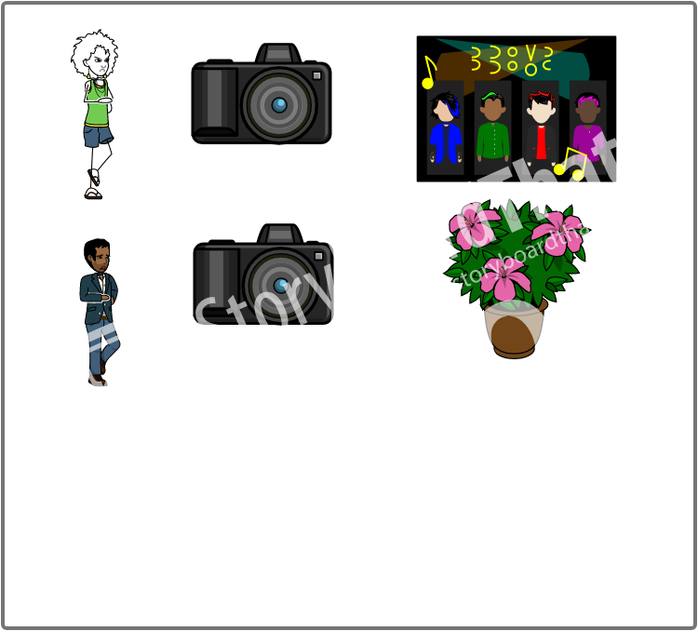
We Need Gadgets
Scan the items to reveal gadgets

Slide 5
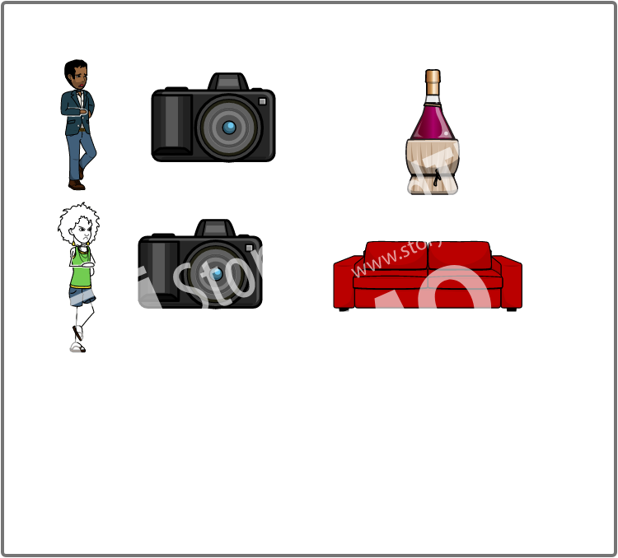
WE NEED CLUES
Scan the gadgets for clues to the bomb

Slide 6
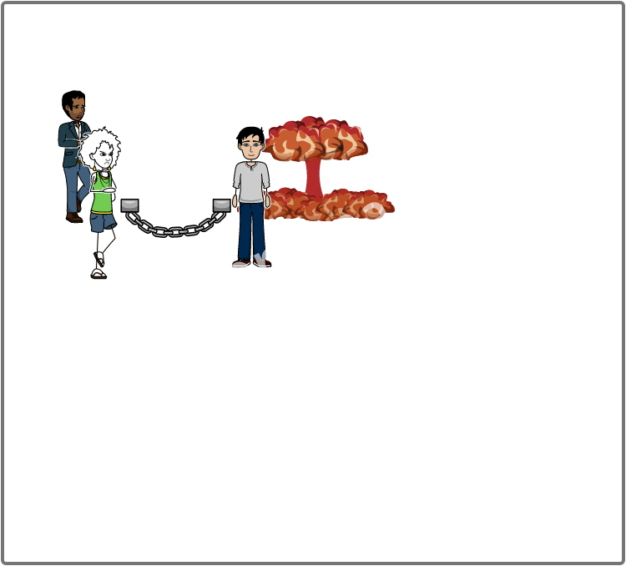
Gotcha
Reveal the thief to recover the bomb

Slide 7
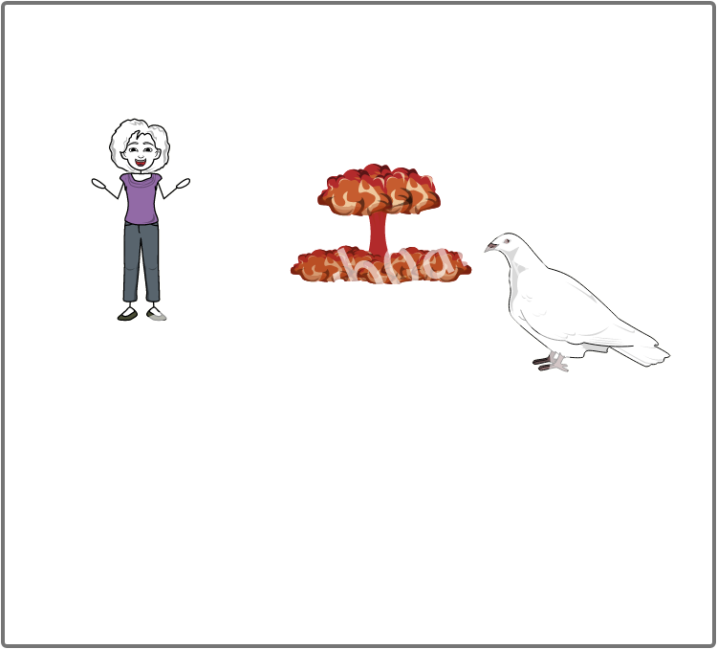

Add Title Here
Em has her bomb back, parliament is safe and there is peace

